Slide 1
Joseph E. Gonzalez
Co-director of the RISE Lab jegonzal@cs.berkeley.edu
Natural
Language
Processing
(NLP) Systems

Slide 2
Applications?
Speech recognition
Predict text from sound
Machine translation
Predict text from text
Text to speech
Predict sound from text
Sentiment analysis
Predict sentiment from text
Automated question answering
Predict text from (text, images, datasets)
Information retrieval
Ranking/clustering (text, images, and data) according a query

Slide 3
What makes language challenging?
Representation (inputs)
Images are easy to represent as tensors
Word sequences are more complex
Often structured prediction (outputs)
Example: predicting complete sentences
Requires semantic knowledge and logical reasoning
“One morning I shot an elephant in my pajamas. How he got into my pajamas I’ll never know.”
Substantial variation across languages
Each language historically required different methods

Slide 4
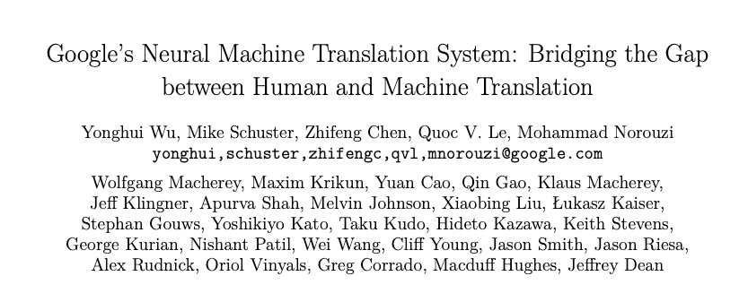
Two NLP Systems Papers
Speech Recognition
Machine Translation
Describe production solutions
Present a full systems approach spanning training to inference
Present the interaction between systems and model design

Slide 5
Context
2015
2014

Slide 6
Context
2015
2014
Demonstrated the viability of an end-to-end deep learning approach to speech recognition
Previously: HMMs with (deep) acoustic models.
Wreck
a
nice
beach

Slide 7
DeepSpeech2:
Improves the model architecture (8x Larger)
Elaborates on the training and deployment process
Provides a more complete description and analysis of the system
2014

Slide 8
Big Ideas
Demonstrates super human performance from an end-to-end deep learning approach
Input spectrograms, output letters (graphemes, bi-graphemes)
Presents a single model and system for both English and Mandarin Speech Recognition
Previous work required separate approaches
Well presented/evaluated ideas:
Data collection and preparation
System training and inference performance
Ablation studies for many of the design decisions

Slide 9
Model Innovations
Predict letters (pairs of letters) directly from spectrograms
Emerging trend at this point
Deeper Models enabled by:
Heavy use of batch normalization
SortaGrad curriculum learning
Train on shorter (easier) inputs first → improves/stabilizes training
2D convolution on spectrogram inputs
Striding to reduce runtime

Slide 10
Simple 5-Gram language model
Prediction requires beam search to maximize

Slide 11
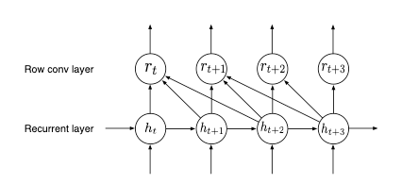
Model and System Co-Design
Minimize bi-directional layers to enable faster inference
Introduce row convolutions
Bidirectional
RNN
Placed at top of network

Slide 12
Variations in approach for Mandarin
Key Observation: Minimal changes required
Did not need to explicitly model language specific pronunciation
Output requires extension to 6000 characters + Roman alphabet
Shorter beam searches

Slide 13
Data Preparation
Used models to align transcription with audio
Used models to identify bad transcriptions
Data augmentation
Adding synthetic noise
Constructed human baseline

Slide 14
Systems Innovations in Training
Synchronous Distributed SGD for better reproducibility
Custom GPU implementation of CTC Loss
Combinatorial evaluation
Optimized all-reduce with GPUDirect communication
Substantial performance gains
Custom memory allocators and fallback for long utterances
45% of peak theoretical performance per node.

Slide 15
Innovations during Inference
Batch Dispatch:
Combines queries when possible to improve throughput
Low bit precision (16bit) floating point arithmetic
Optimized Small Batch GPU GEMM Kernels
Reduced beam search to most likely characters
Speeds up Mandarin by 150x
P98 latency of 67 milliseconds with 10 streams per server
Is this good?

Slide 16
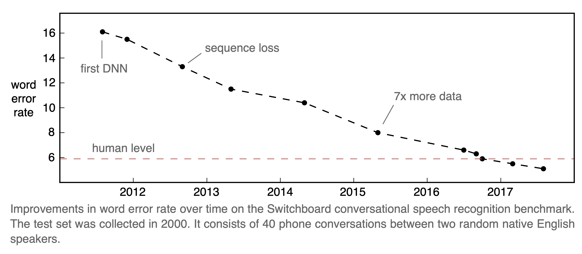
Metrics of Success
Word error rate
Similar to edit distance measures frequency of substitutions, deletions, and insertions
https://awni.github.io/speech-recognition/

Slide 17
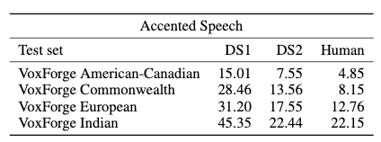
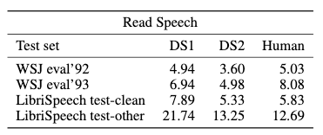
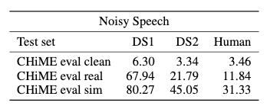
Big Results
Outperforms humans on several benchmarks
Notes:
Current state of the art on librispeech test-clean is 3.43

Slide 18
Limitations and Future Impact
Future Impact
Provided substantial evidence of end-to-end approach
May be in use at Baidu?
Batching techniques appear in other inference systems
Limitations
Not clear how to personalize?
Substantial computational costs at prediction time
Difficult to reproduce results (no code or data released)

